Slide 1
LESSON EIGHTEEN
TOPICS: HOW TO RESET THE TARGET.

Slide 2
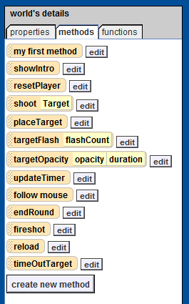
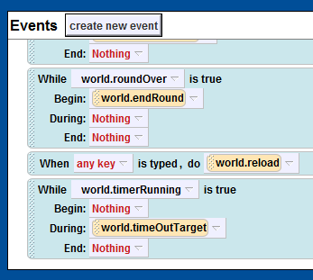
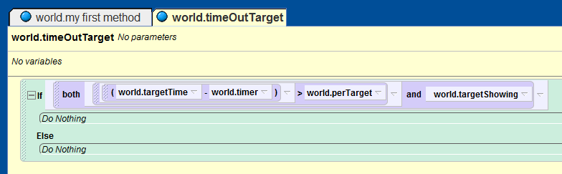
Step 1: Check to See that the Game is still Running
Create a new world method called “timeOutTarget”.
Create a new “while something is true” event with the condition “world.timerRunning” and where the durring portion of the event calls the new “world.timeOutTarget” method.
Add an if block to the “world.timeOutTarget” method with the condition “(world.TargetTime – world.Timer) > world.perTarget and world.targetShowing.”

Slide 3
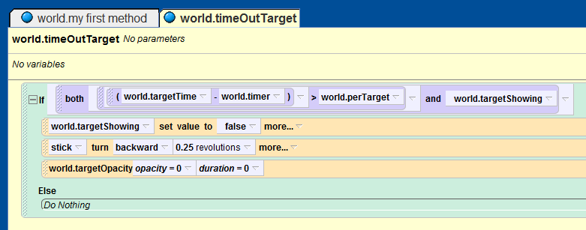
Step 3: How to Make the Target Pop-Up
Add the following lines of code to the if-statement in the “world.timeOutTarget” method:
“world.targetShowing = false”
“stick.turn backwards 1/4 revolution duration 5 seconds”
“World.targetOpacity” with opacity set to 0 and duration to 0.
Run you world and watch the target turn up and turn down.

Slide 4
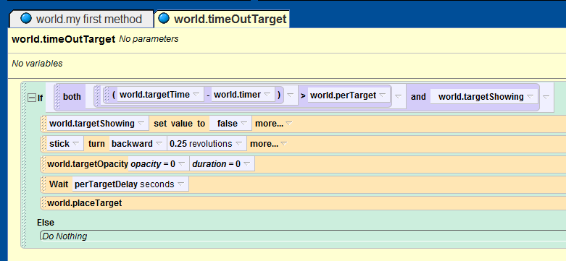
Step 3: Adding the Finishing Touches
Create a new world number variable named “perTargetDelay” and set its value to “5”.
Add a “wait” statement to the end of the if-statement in the “world.timeOutTarget” method.
Set the duration of the new wait statement to “world.perTargetDelay”.
Below the new wait statement, add a call to the “world.placeTarget” method.

Slide 5
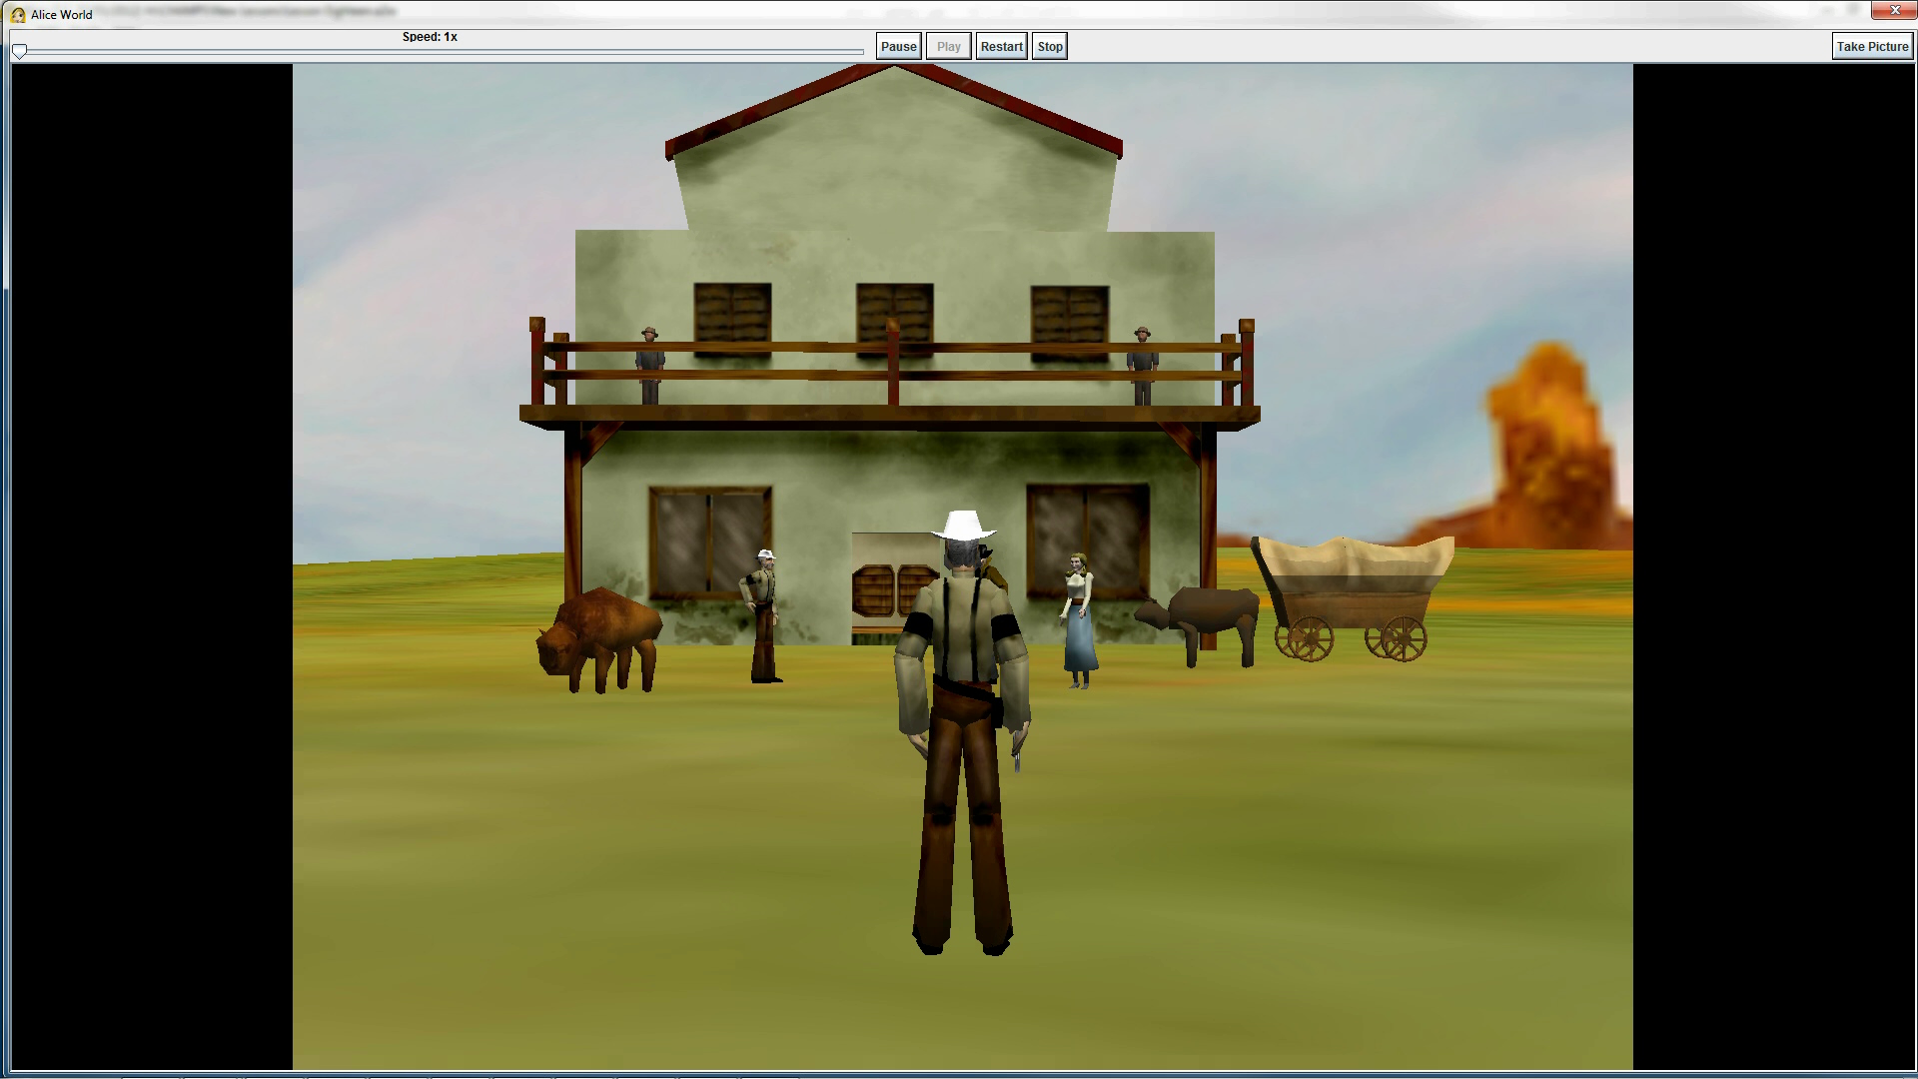
Final Scene

